Slide 1
Brainstorm
1) What is the atmosphere?
2) Why is the atmosphere important to us?
3) What is our atmosphere made of?

Slide 2
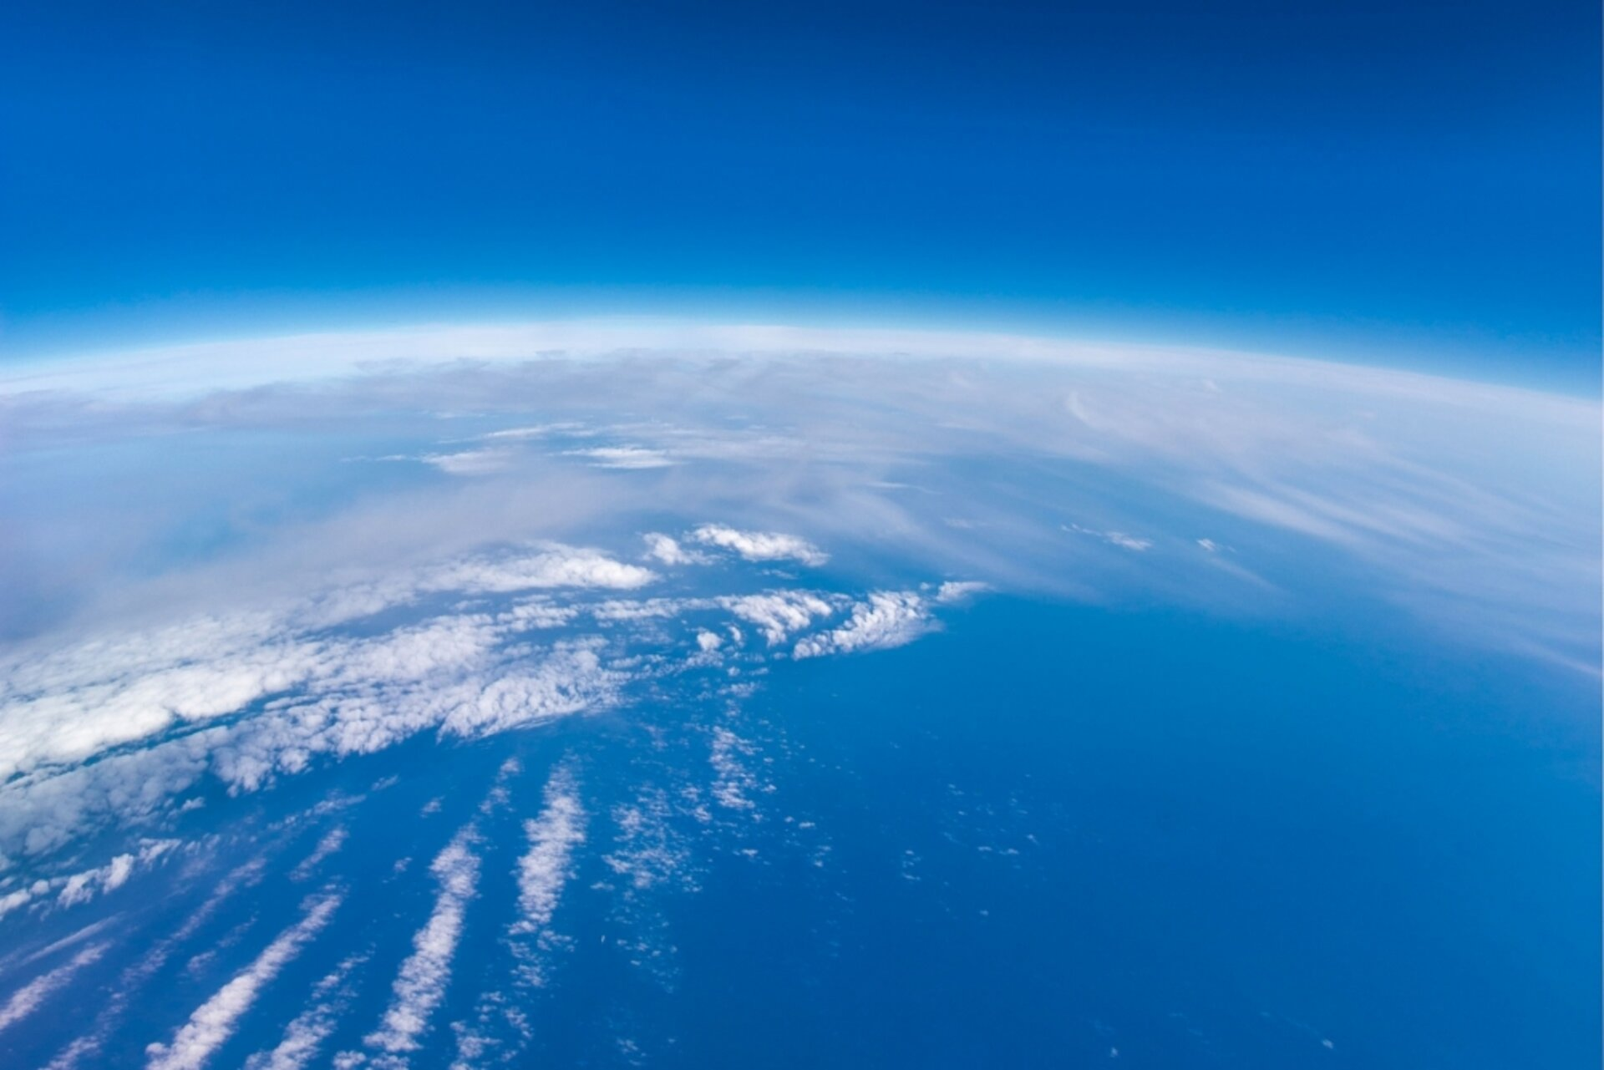

Slide 3
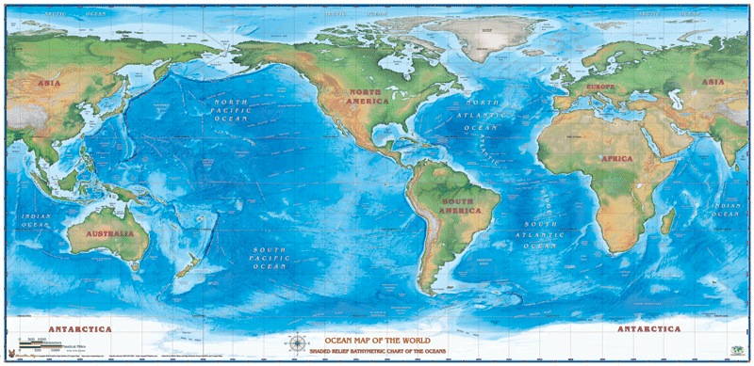

Slide 4
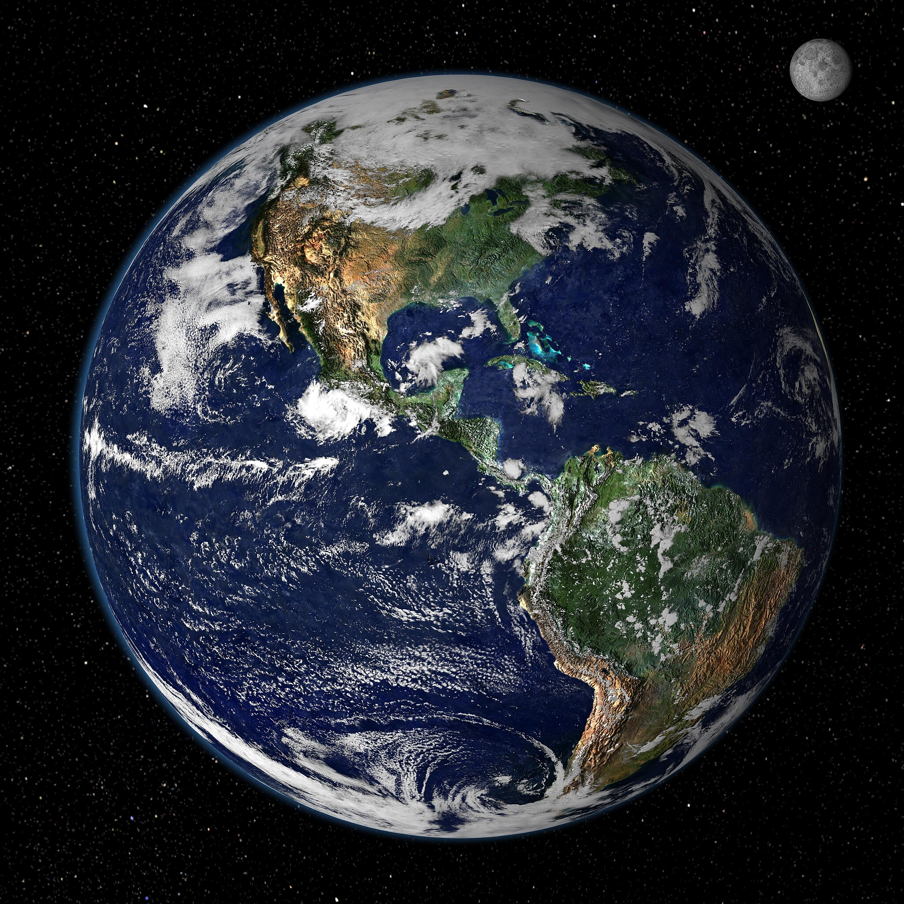
Brainstorm https://www.youtube.com/watch?v=EceyCgxG1c8
What things is our Earth “covered by”?
What surfaces would heat faster/slower than others?
How does what happens on the surface change the air above the surface?

Slide 6
Unit 4: Earth’s Atmosphere

Slide 7
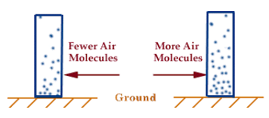
Low Pressure Air vs. High Pressure Air

Slide 8
Cold Air vs. Hot Air

Slide 9
Land vs. Water Heating

Slide 10
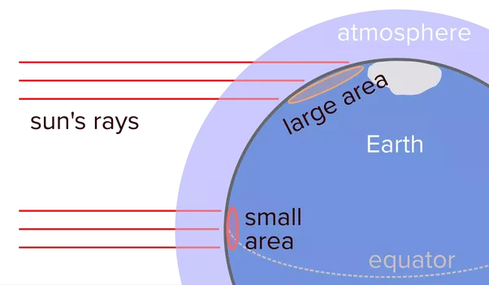
Poles vs. Equator Heating

Slide 11
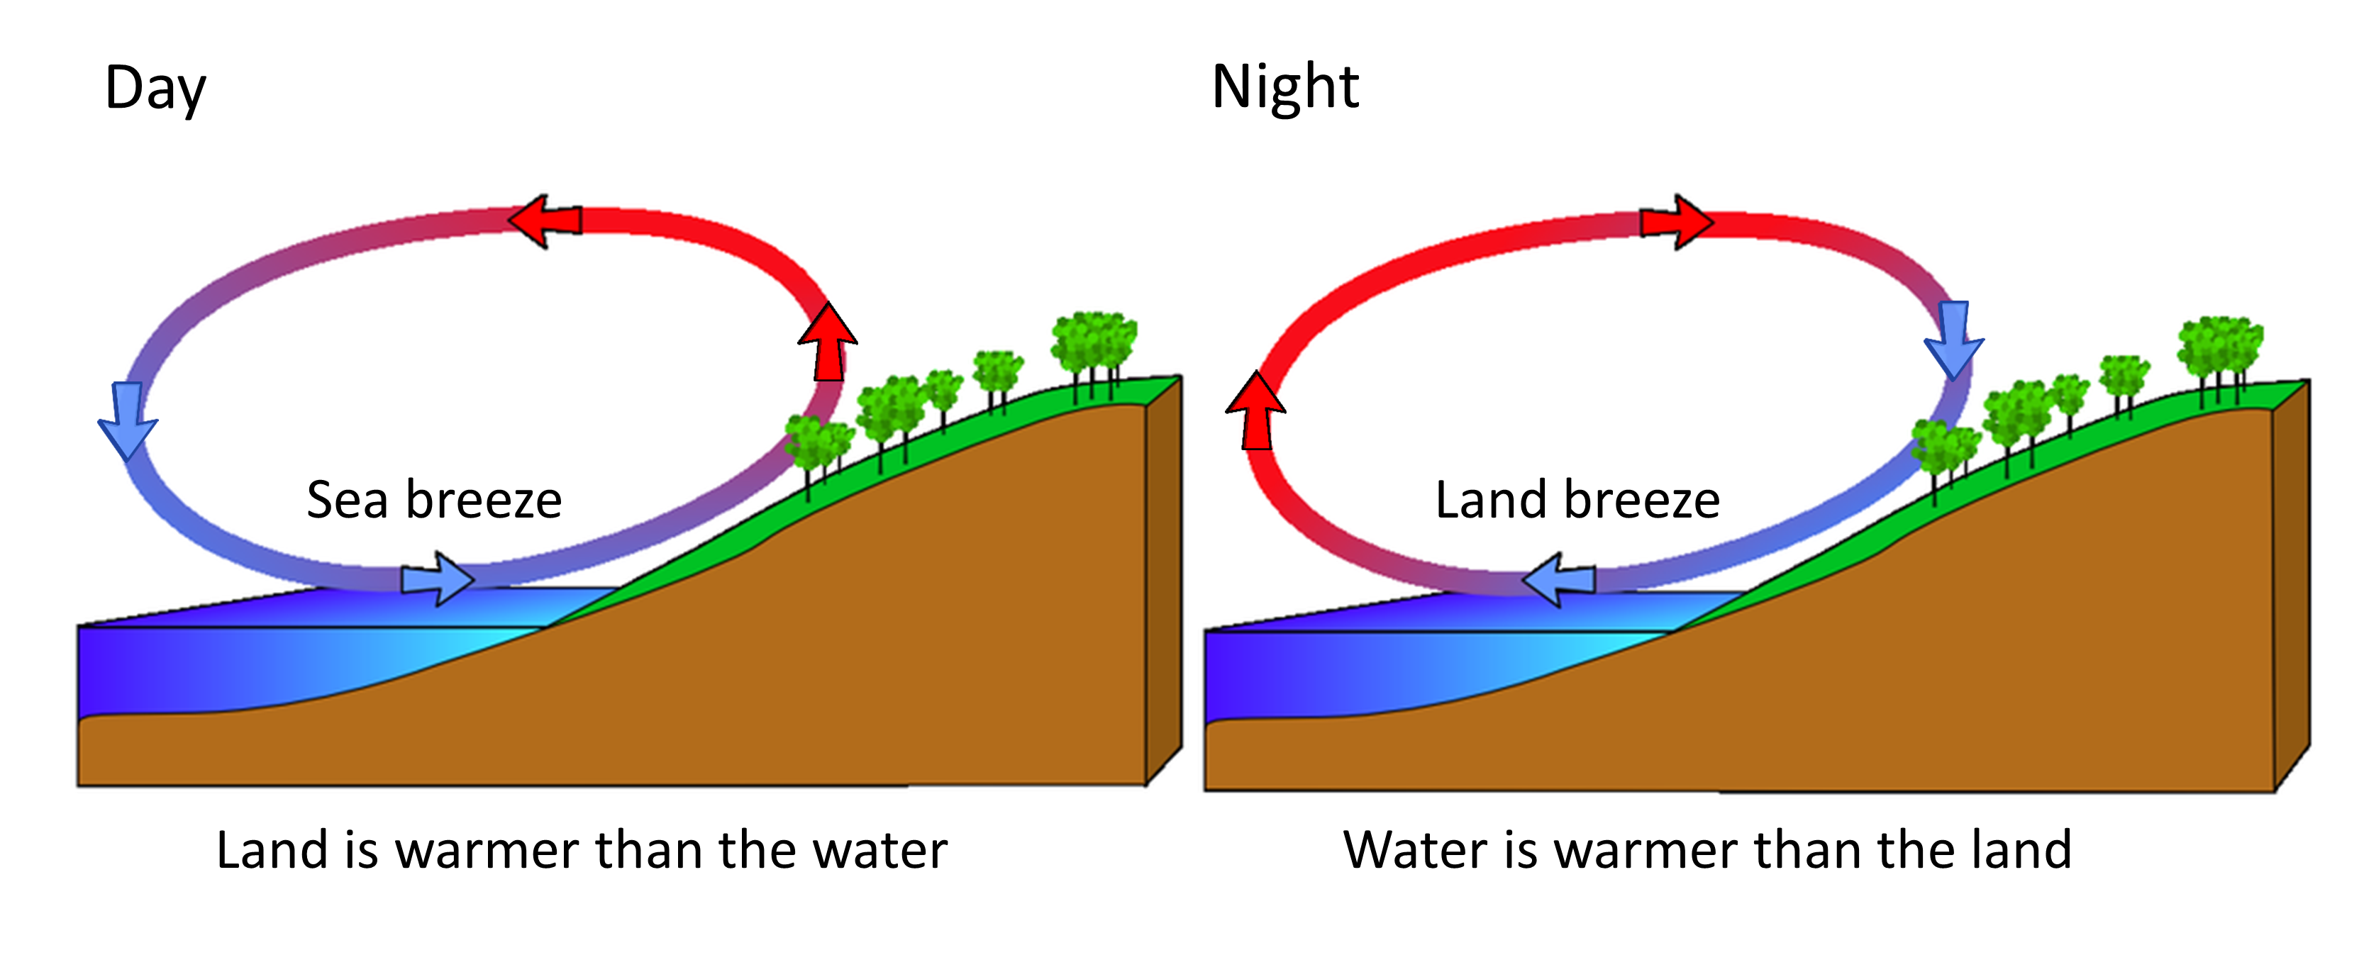
Night vs. Day Heating

Slide 12
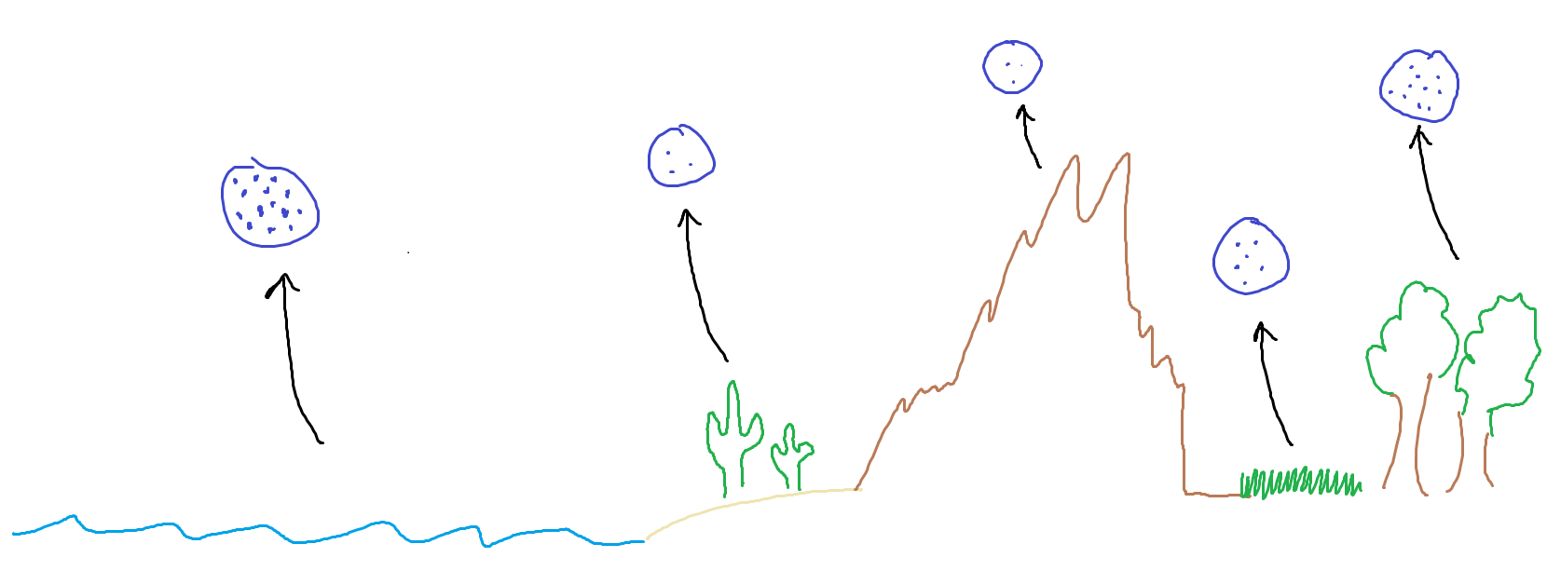
Humidity of Land vs. Water

Slide 13
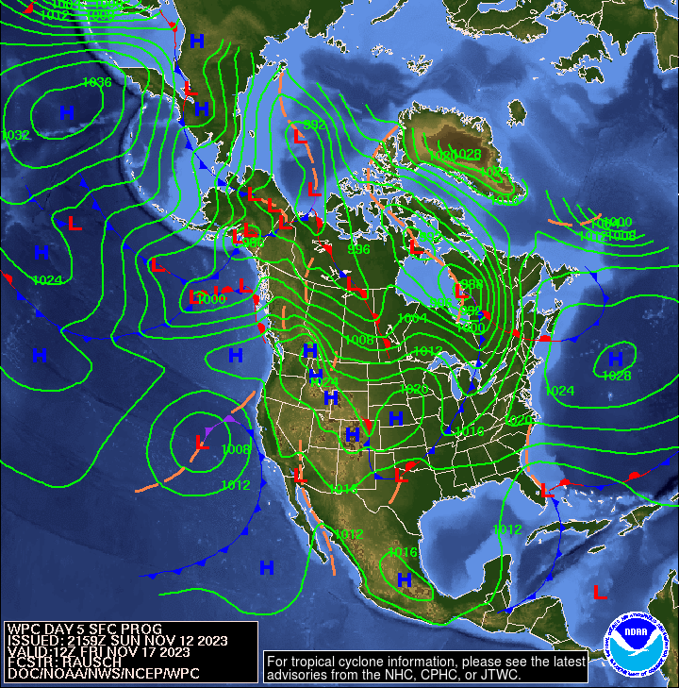
Put it all together and you get….WEATHER!

Slide 14
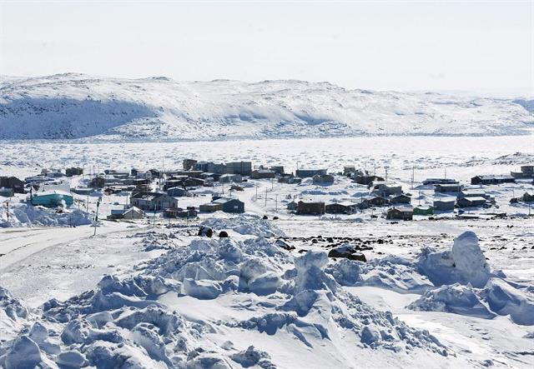
Humidity
Amount of water in the air

Slide 16
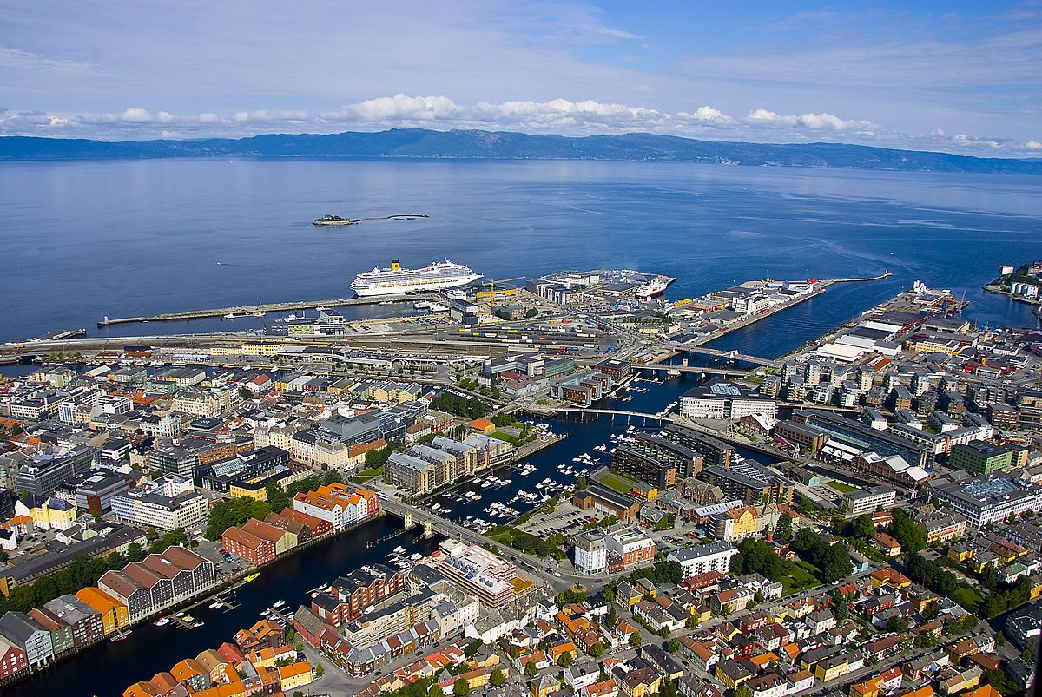
Tronheim Norway vs. Froshbisher Bay Canada

Slide 18
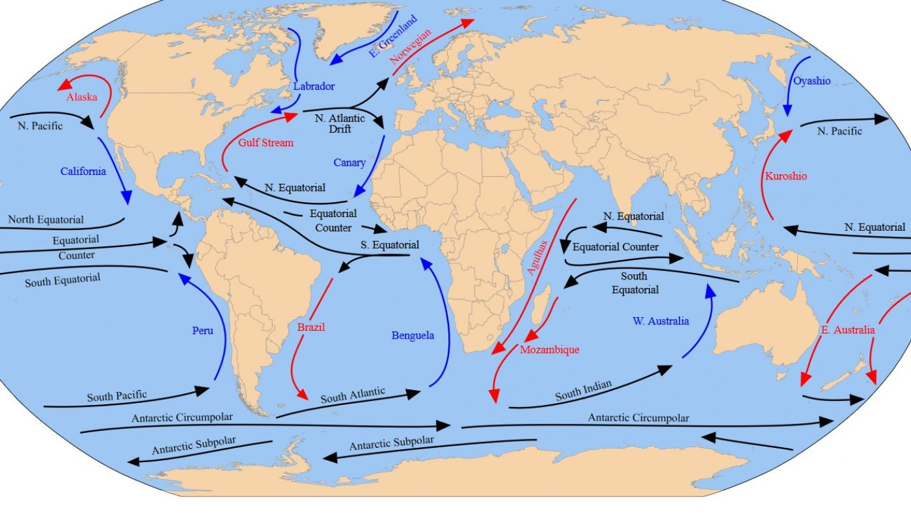

Slide 19
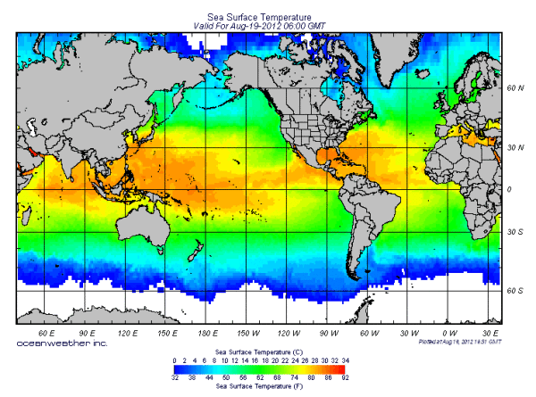

Slide 20
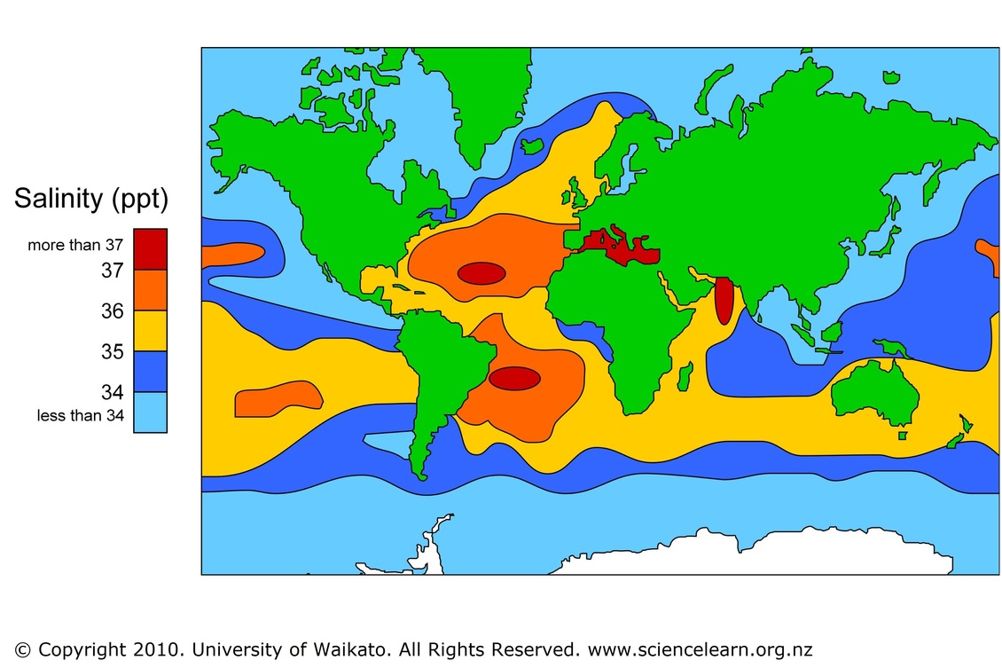

Slide 21
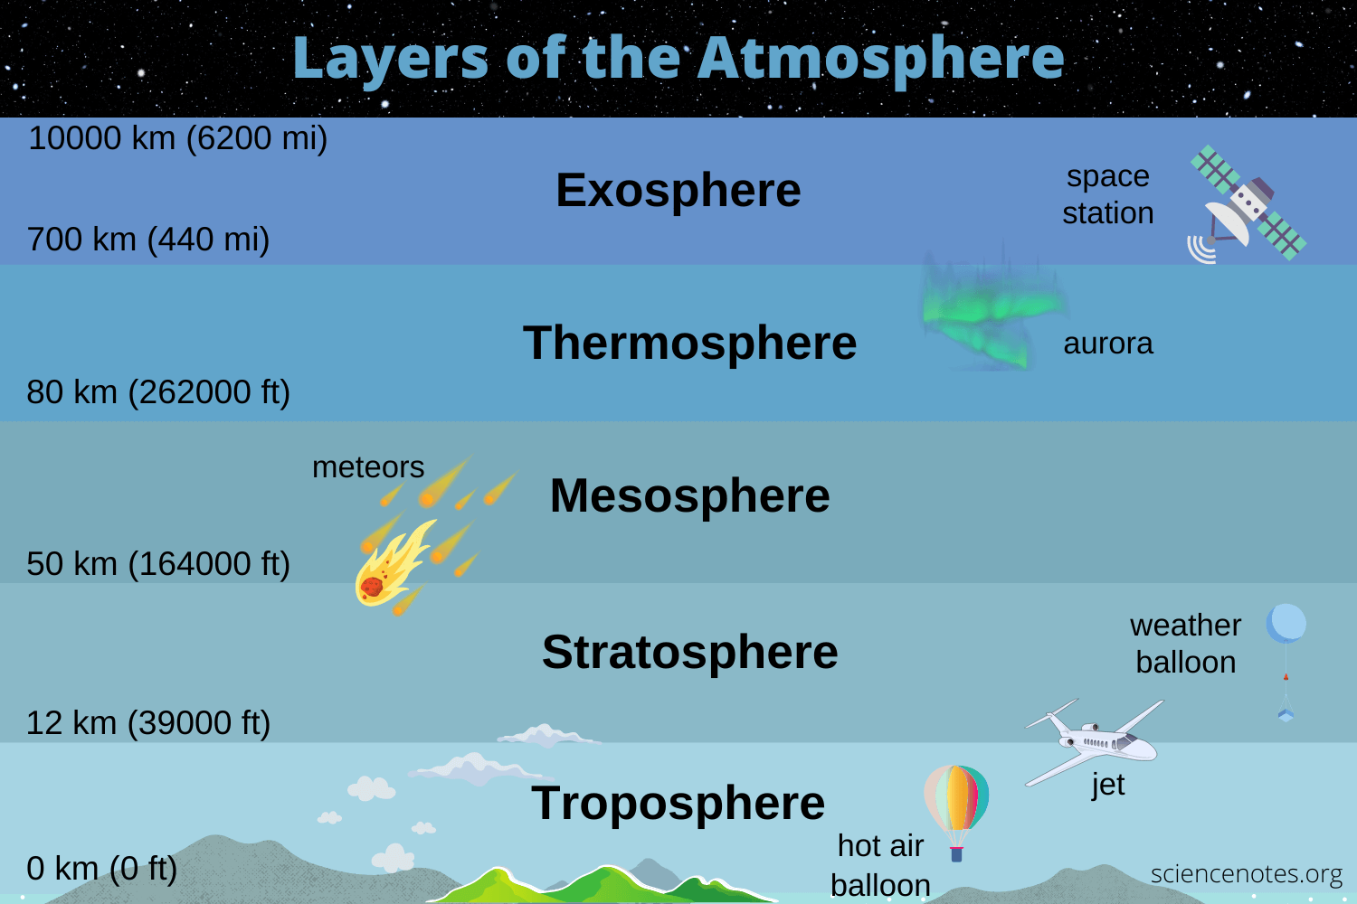

Slide 22
Brainstorm
1) What causes…
Lightning
Thunder
Hurricanes
Storms

Slide 23
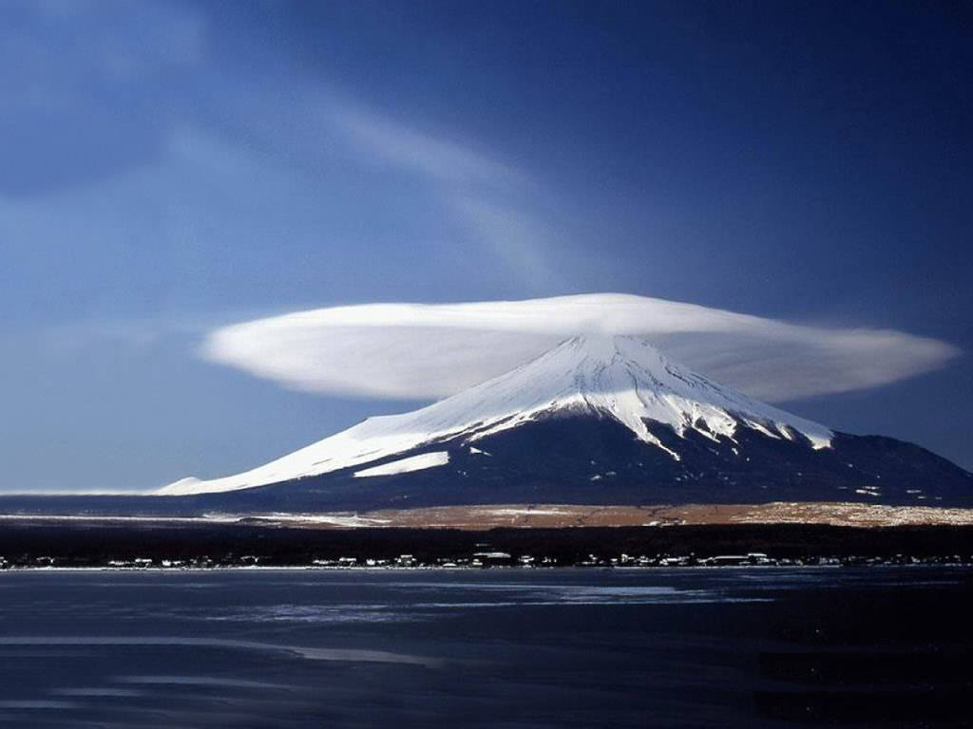
Types of Clouds

Slide 24
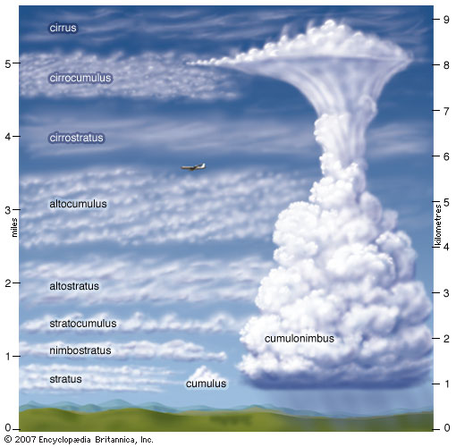

Slide 25
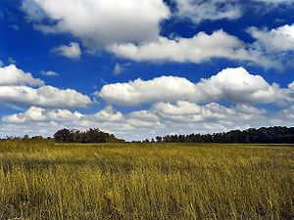
Cumulus

Slide 26
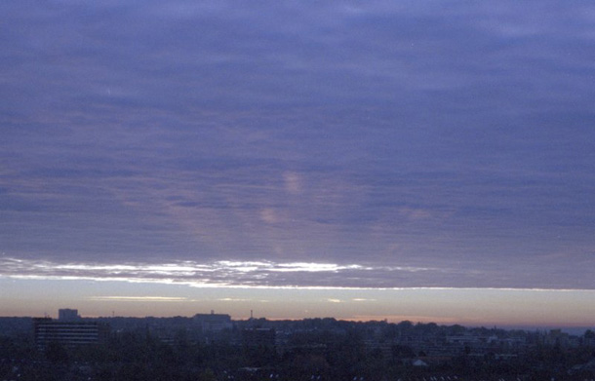
Stratus

Slide 27
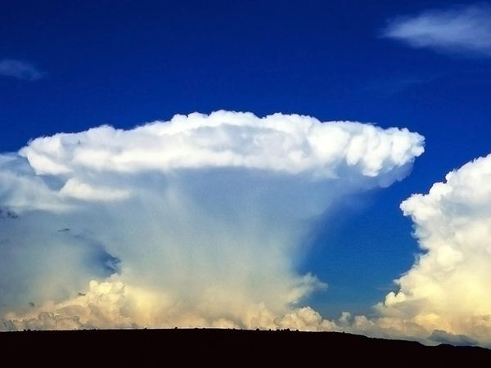
Cumulonimbus

Slide 28
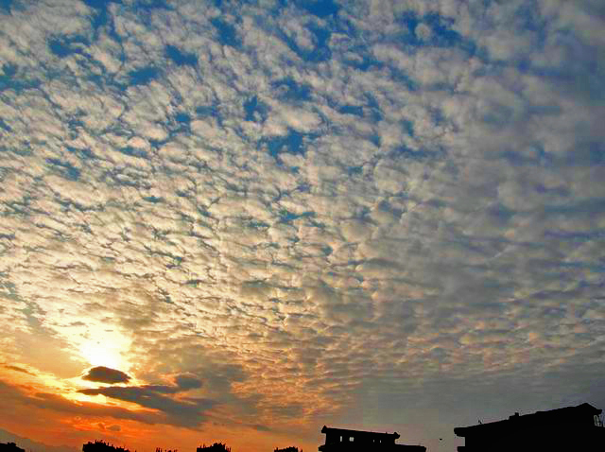
Altocumulus

Slide 29
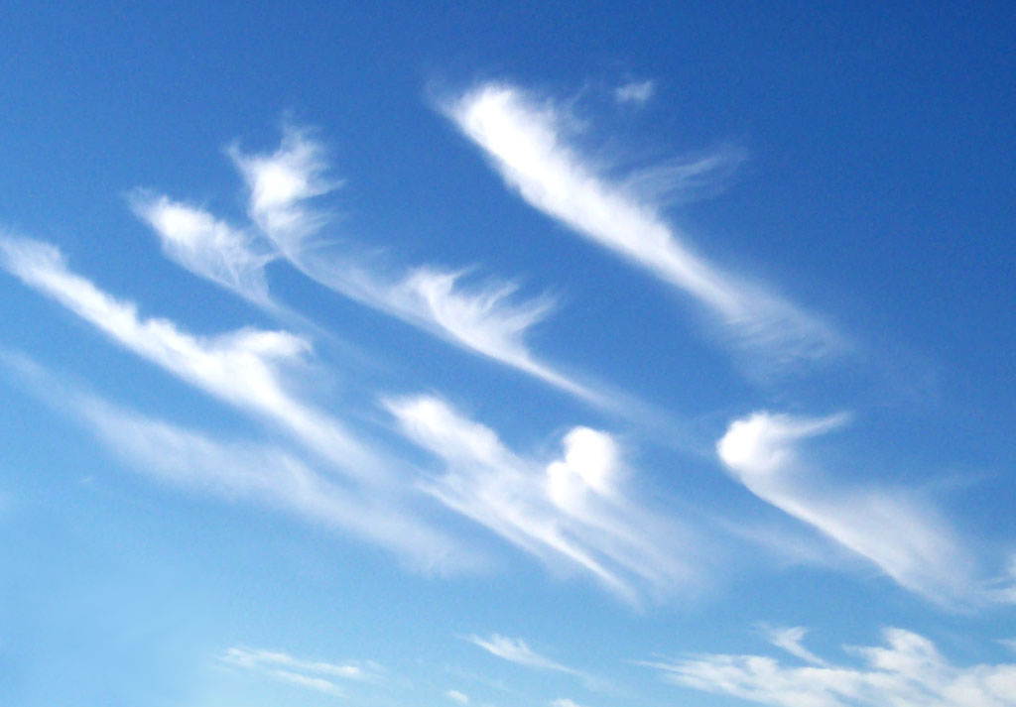
Cirrus Clouds

Slide 30
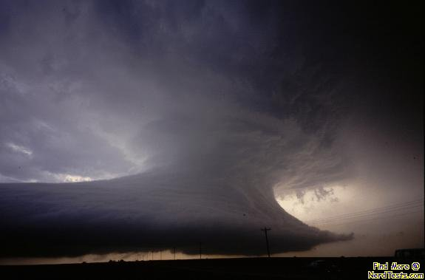
Wall Clouds

Slide 31
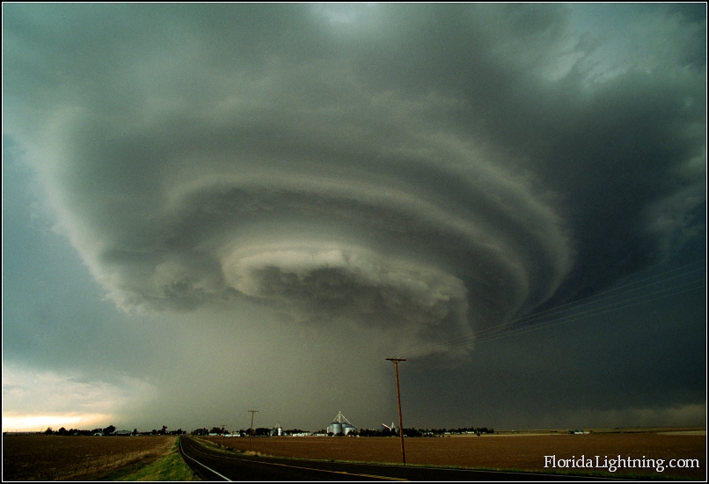
Wall Cloud

Slide 32
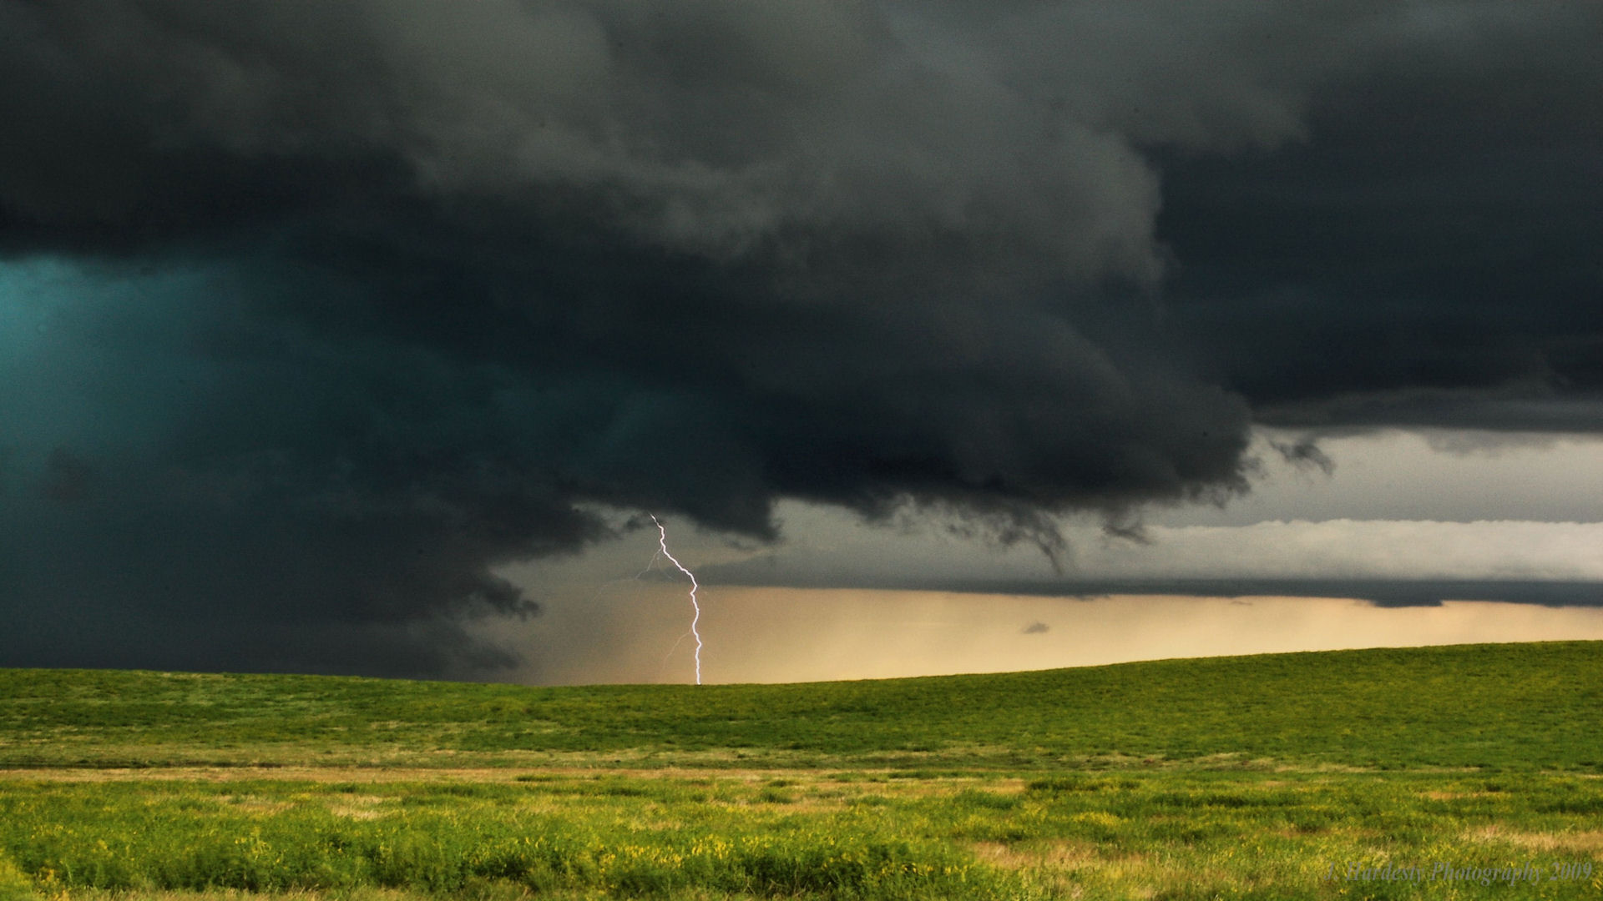
Wall Cloud

